Slide 1

Futurense
Democratizing Tech Talent to deliver impact at scale

Slide 2
INDIAN HEALTHCARE
ANALYSIS
FARYAR MEMON - FT641

Slide 3
Overview:
Brief Description: This project aims to analyze the healthcare infrastructure in India using data on census, housing, hospitals, and other relevant factors. With a wide range of healthcare facilities, from globally acclaimed hospitals to those providing unacceptably low quality care, issues such as a shortage of hospital beds can have serious consequences, as seen during the COVID-19 pandemic.
Business Problem: The project's objective is to identify gaps and areas of improvement in the healthcare infrastructure of different states in India. This information can be used to develop strategies and policies to improve healthcare access and outcomes in these states.
Solution Approach: The solution approach involves preprocessing the data using classes and functions, mapping relevant features using GeoPandas, and analyzing the data using various visualization techniques. The goal is to provide insights and recommendations for improving healthcare in the country, including developing strategies and policies.

Slide 4

Tools and Technologies Used:
Tool 2
Tool 3
Tool 4
PYTHON

Slide 5





Libraries/Packages/Features Used:
NumPy: Uses for mathematical calculations.
Pandas: Used to manipulate and transform the data in the tables of the database, specifically for features such as vectorization.
GeoPandas: Used to create GeoDataFrames and GeoDataSeries used to create map for geospatial analysis.
Matplotlib: Used to create basic plots and was frequently used to customize other visualizations created using Seaborn.
Seaborn: Used for data visualization mainly because of its easy syntax and available themes and palettes.
Classes (OOPs): Created for reuse of functions, the dataframes were used as an instance variable, thereby unique to each object ex., census, housing, hospitals, etc.

Slide 6
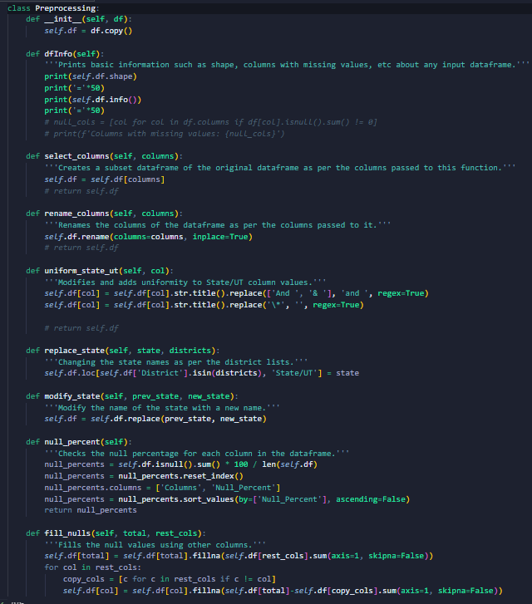
Headline Statistics:
IDE/Code Editor Used: VS Code
Function/Complexity breakdown:
Simple Implementations
Intermediate Implementations
Complex Implementations

Slide 7
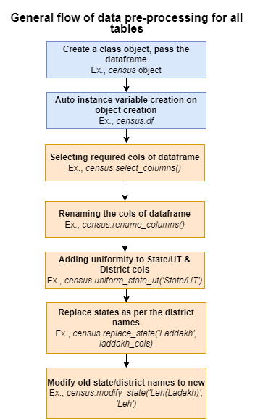
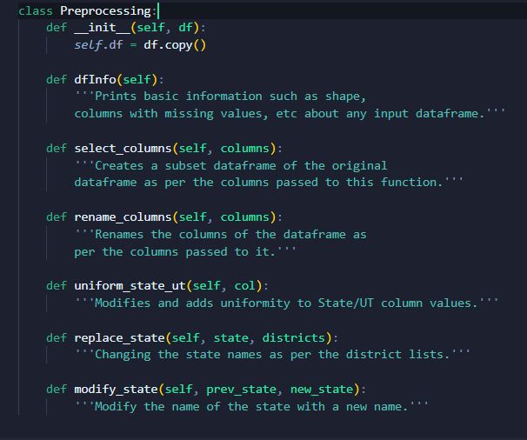
#1 Data Pre-processing:

Slide 8
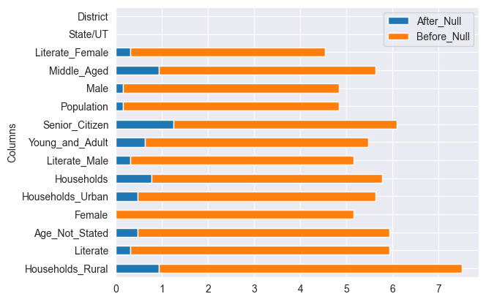
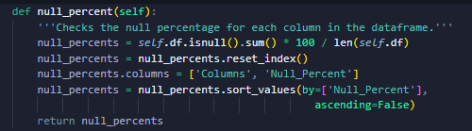
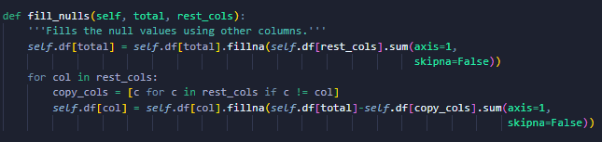
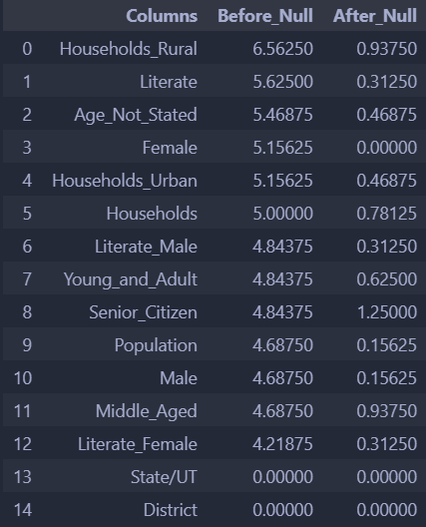
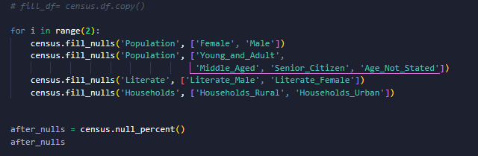
#2 Handling Missing Data:
Graph 1.
Insights:
The percentage of missing data after filling the null values is around the range of 0 to 1.5% which is relatively very low.
Percentage
First find the missing value percentage for each column.
Apply fill_nulls() for each column involved:
Population = Male + Female
Literate = Literate_Male + Literate_Female
Population = Young_and_Adult+ Middle_Aged + Senior_Citizen + Age_Not_Stated
Households = Households_Rural + Households_Urban
Check for missing value percentage after filling them.
Code Implementation
Code Output

Slide 9
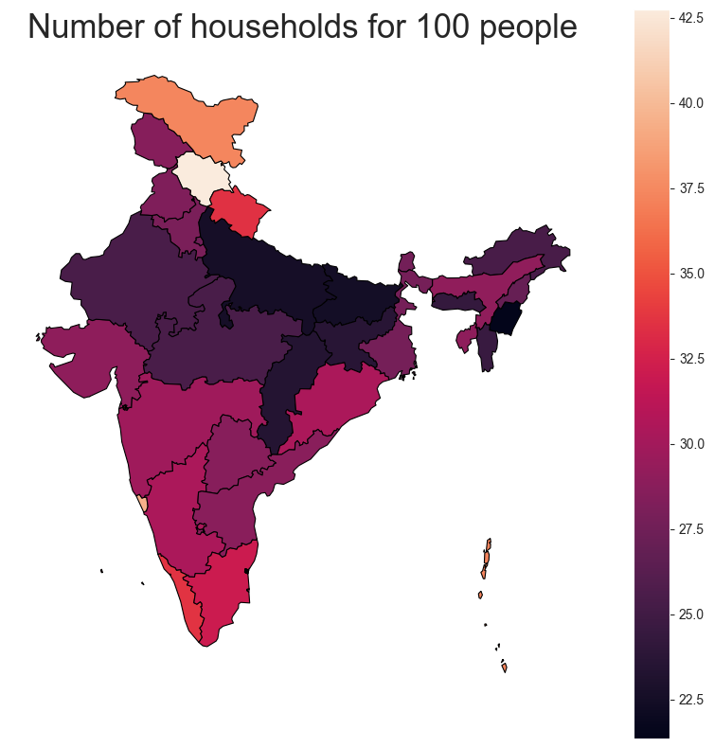
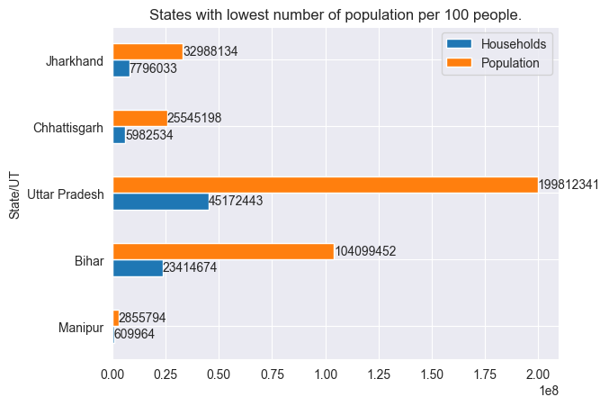
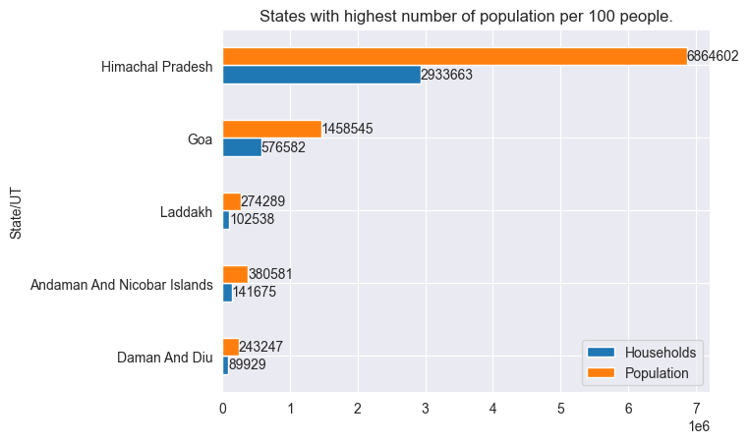
#3 Household Density in India:
States with lowest number of households that can accommodate 100 people: Manipur (21.36), Bihar (22.49), Uttar Pradesh (22.61) and higher are Himachal Pradesh (42.73), Goa (39.53), Laddakh (37.38).
So, such states with low household densities have fewer houses per 100 people may face challenges in providing adequate healthcare facilities to the population. Aside from that, they have a greater risk of faster spread of diseases and infections due to high population living in fewer households.
States with high household densities can be densely populated or can be potentially overcrowded. We require more housing conditions to have an accurate conclusion about that.
Laddakh
37.383
Himachal Pradesh
42.736
Uttar Pradesh
22.61
Bihar
22.492
Manipur
21.358
Graph 3
Goa
39.531314
Graph 2
Graph 1.
Notes:
Low household density: There may be higher number of people living in a single household

Slide 10
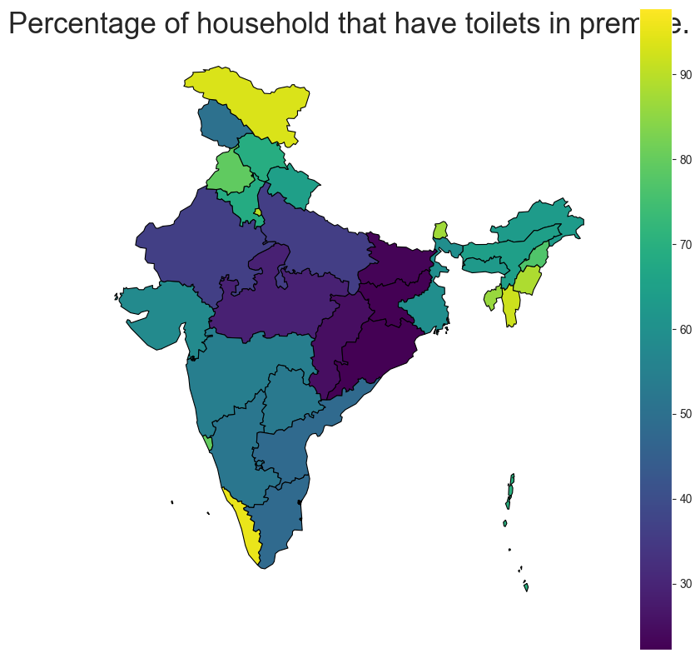
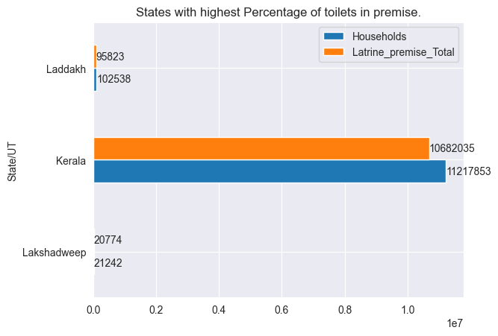
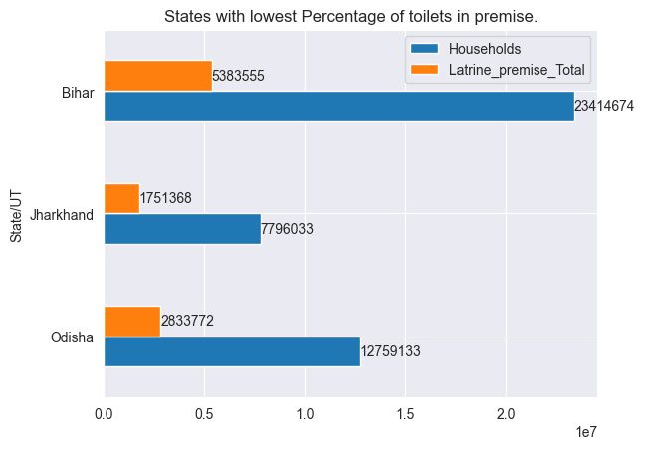
#4 Household Sanitation in India:
States with highest percentage of toilets in premise: Lakshadweep, Kerala, Ladakh have better access to basic sanitation facilities, which can lead to better health outcomes.
States with lowest percentage of toilets in premise: Odisha, Jharkhand & Bihar may have a higher prevalence of diseases related to poor sanitation.
Recommendations:
The government should invest more to increase the no of households with in-house latrine premises
Prioritize improving access to basic sanitation facilities to reduce the prevalence of diseases related to poor sanitation.
The government can launch awareness campaigns, provide financial incentives to households that build toilets in their homes, etc.
Laddakh
93.45%
Bihar
22.99%
Jharkhannd
22.464%
Odissha
22.209%
Lakshadweep
97.8%
Kerala
95.22%
Graph 1.
Graph 2
Graph 3
Notes:
Low household density: There may be higher number of people living in a single household

Slide 11
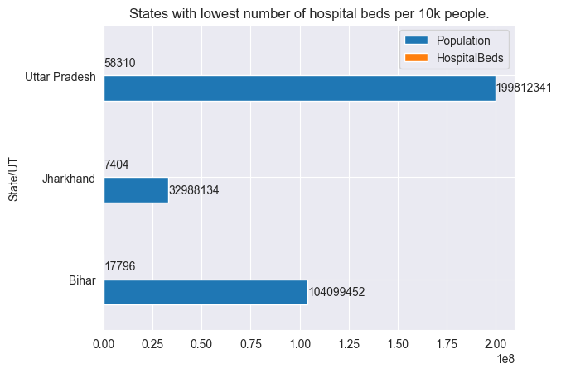
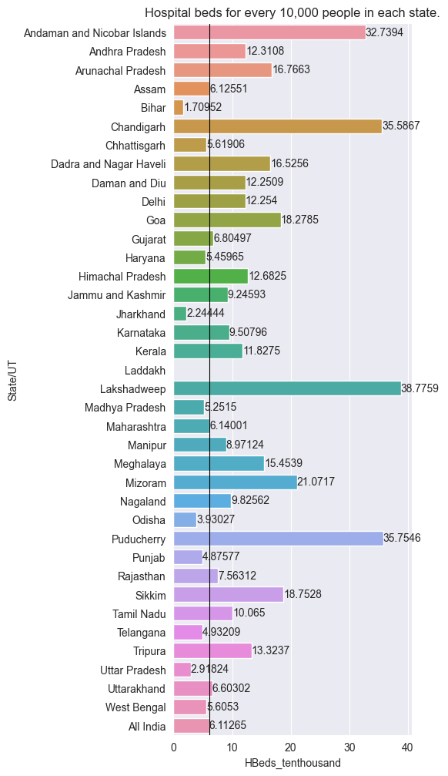
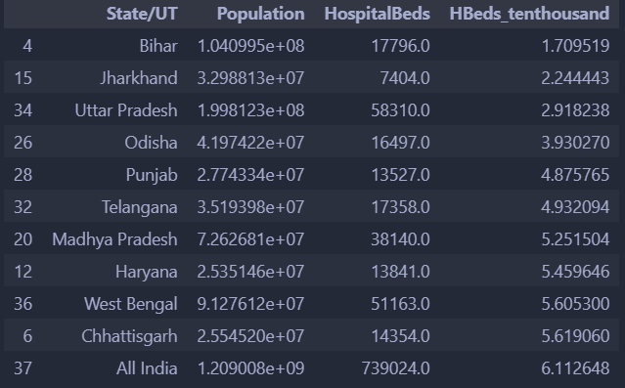
#5 State-wise Hospital Bed Capacity in India:
Considering All India as benchmark, we got an approx value of 6 beds per 10k people.
States exceeding the threshold: Lakshadweep (max) and there are some states where they fall below this range and may be more vulnerable to healthcare crises and may require more investment in healthcare infrastructure.
Top 3 states with least no. of hospital beds per 10k people: Bihar, Jharkhand & Uttar Pradesh.
Reasons: State Population doesn’t meet the demand of the hospital beds per 10k people.
Graph 2.
Code Output
Graph 1.

Slide 12
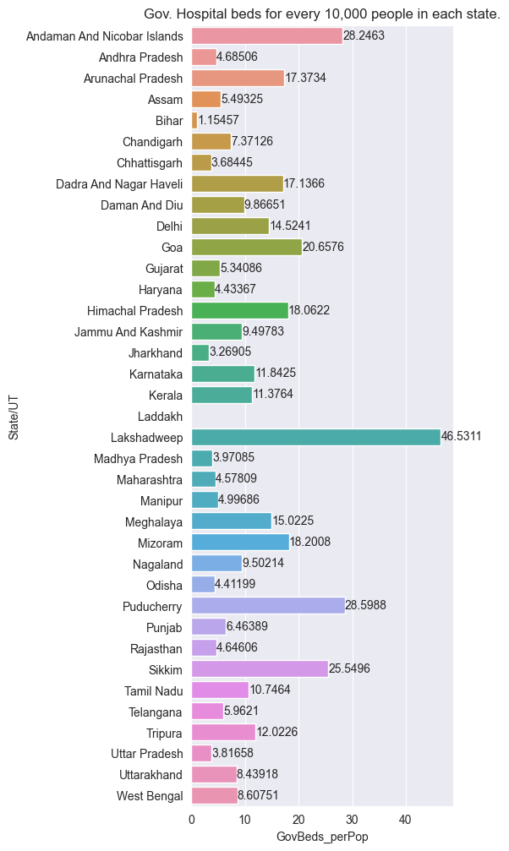
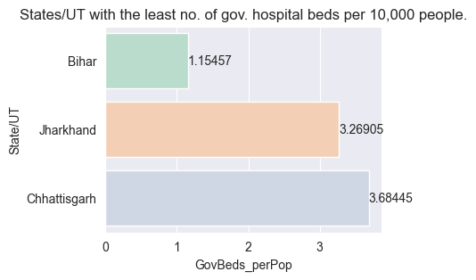
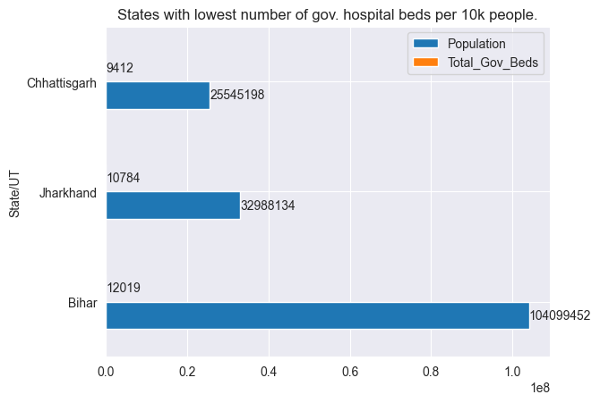
#6 State-wise Government Hospital Bed Capacity in India:
States with lowest number of government hospitals per 10k people:
Bihar
Jharkhand
Chhattisgarh
Reasons: High population doesn’t meet the hospital beds requirement in government hospitals.
States with highest number of government hospitals per 10k people:
Lakshadweep
Puducherry
Andaman And Nicobar Islands

Slide 13
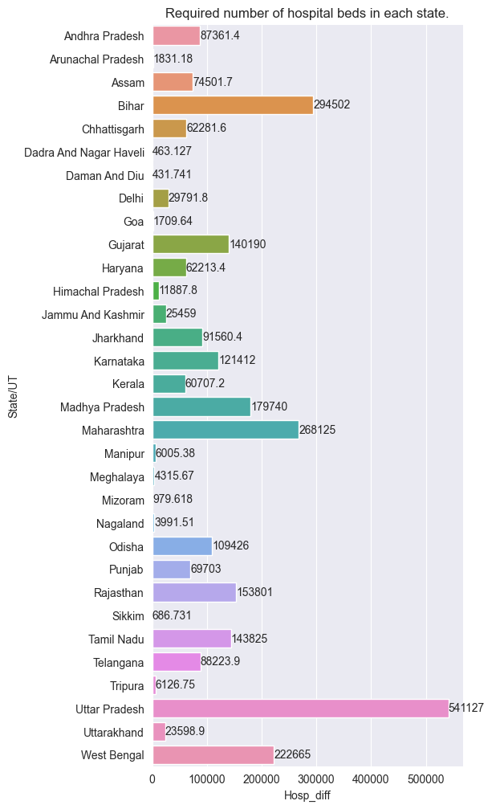

#7 Gap analysis of hospital bed availability in Indian
states with WHO standard:
WHO Standards: 3 beds per 1000 people
The state which requires the maximum amount of hospital beds to meet the WHO standards is Uttar Pradesh (541127), followed by Maharashtra (268125).

Slide 14
Conclusions & Recommendations
The government needs to invest more to increase the number of households in Manipur to reduce the spread of infectious diseases during a healthcare crisis.
Bihar & Jharkhand needs more households and especially house with toilets.
Bihar also requires to meet the WHO standard number of hospital beds along with Uttar Pradesh, Maharashtra and West Bengal.

Slide 15
Highlights & Standout Features:
Efficient data preprocessing: The use of classes and their functions to preprocess the dirty dataframes multiple times in the same order for different tables is a very efficient and organized way of handling data cleaning and preparation.
Geospatial analysis: The use of Geopandas to map out important features adds a layer of geospatial analysis to the project, allowing for a better understanding of the geographical distribution of the data.
Visualization: The project involves the creation of multiple visualizations, such as bar plots and choropleth maps, which help to convey insights and findings to stakeholders in an easily understandable way.

Slide 16
Optimizations and Best Practices Used:
Use vectorization: Avoid using loops when possible and instead use vectorization to perform operations on entire arrays or data frames at once.
Write modular and reusable code: Write code that can be easily reused and extended for future projects by using modular design patterns and creating functions and classes.
Document your code: Document your code using comments and docstrings to help other developers understand your code and make it easier to maintain.

Slide 17
Future Scope:
Collect more recent and accurate data to provide up-to-date analysis and solutions.
Analyze the correlation between different variables and how they affect the healthcare system in each state.
Explore the impact of government policies on the healthcare system in each state.
Compare the healthcare system in each state to other countries or regions with similar demographics and geography.

Slide 18
THANKYOU

Slide 19




















